Slide 1

PMT Platform
Main building blocks
CONNECT
UNDERSTAND
A governed executive view of project delivery across connected systems of record
RECOMMEND
LEAD
Notes:
PMT Platform overview. Brand artwork supplied by PMT Platform.

Slide 2
PMT Platform building blocks
PMT
Each layer turns source evidence into governed executive decisions
01
Systems of record
Approved connectors retrieve the fields authorized for each source system.
02
Governed integration
Connector profiles, field mapping, data authority, synchronization, and reconciliation.
03
Delivery evidence
Scope, project plans, RAID and milestones, attachments, decisions, ADRs, and audit history.
04
Decision experience
Dashboards, readiness, alerts, exports, and guided help use the same selected scope.
Security, licensing, installation, and audit controls support every layer
PMT Platform
02
Notes:
Source: PMT Platform product architecture and current application experience.

Slide 3
Shared scope and project model
PMT
One governed selection provides context across every PMT tab
PORTFOLIO
PROGRAM
FULL PROJECT
LIGHT PROJECT
Enterprise view
Related initiatives
Complete hierarchy
Focused controls
A consistent operating context
Clear behavior for multiple projects
The selected portfolio, program, or project remains visible while users move among Project Plan, Dashboards, RAID, Readiness, Governance, Alerts, and Audit Trail.
When users select several projects, each record retains its project identity. Full and Light projects share governance controls while preserving the appropriate level of detail.
The scope selector controls the data context. It does not merge source ownership.
PMT Platform
03
Notes:
Source: PMT Platform scope model and current application navigation.

Slide 4
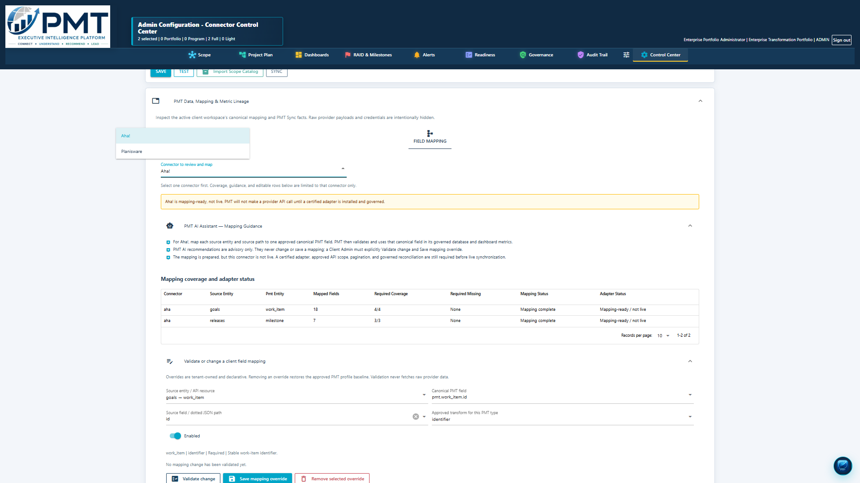
Connector control and field mapping
PMT
Client administrators review one connector at a time and keep the working view manageable
Connector by connector
The administrator selects a source system before reviewing coverage, source entities, and adapter status.
Canonical PMT fields
Source fields map to approved PMT fields that feed Project Plan, dashboards, RAID, governance, and reporting.
Governed changes
The administrator validates and saves an override. Removing it restores the approved baseline for that connector.
PMT guidance explains mapping coverage and required fields without exposing provider credentials or raw payloads.
PMT Platform
04
Notes:
Source: Current PMT Platform connector field mapping experience.

Slide 5
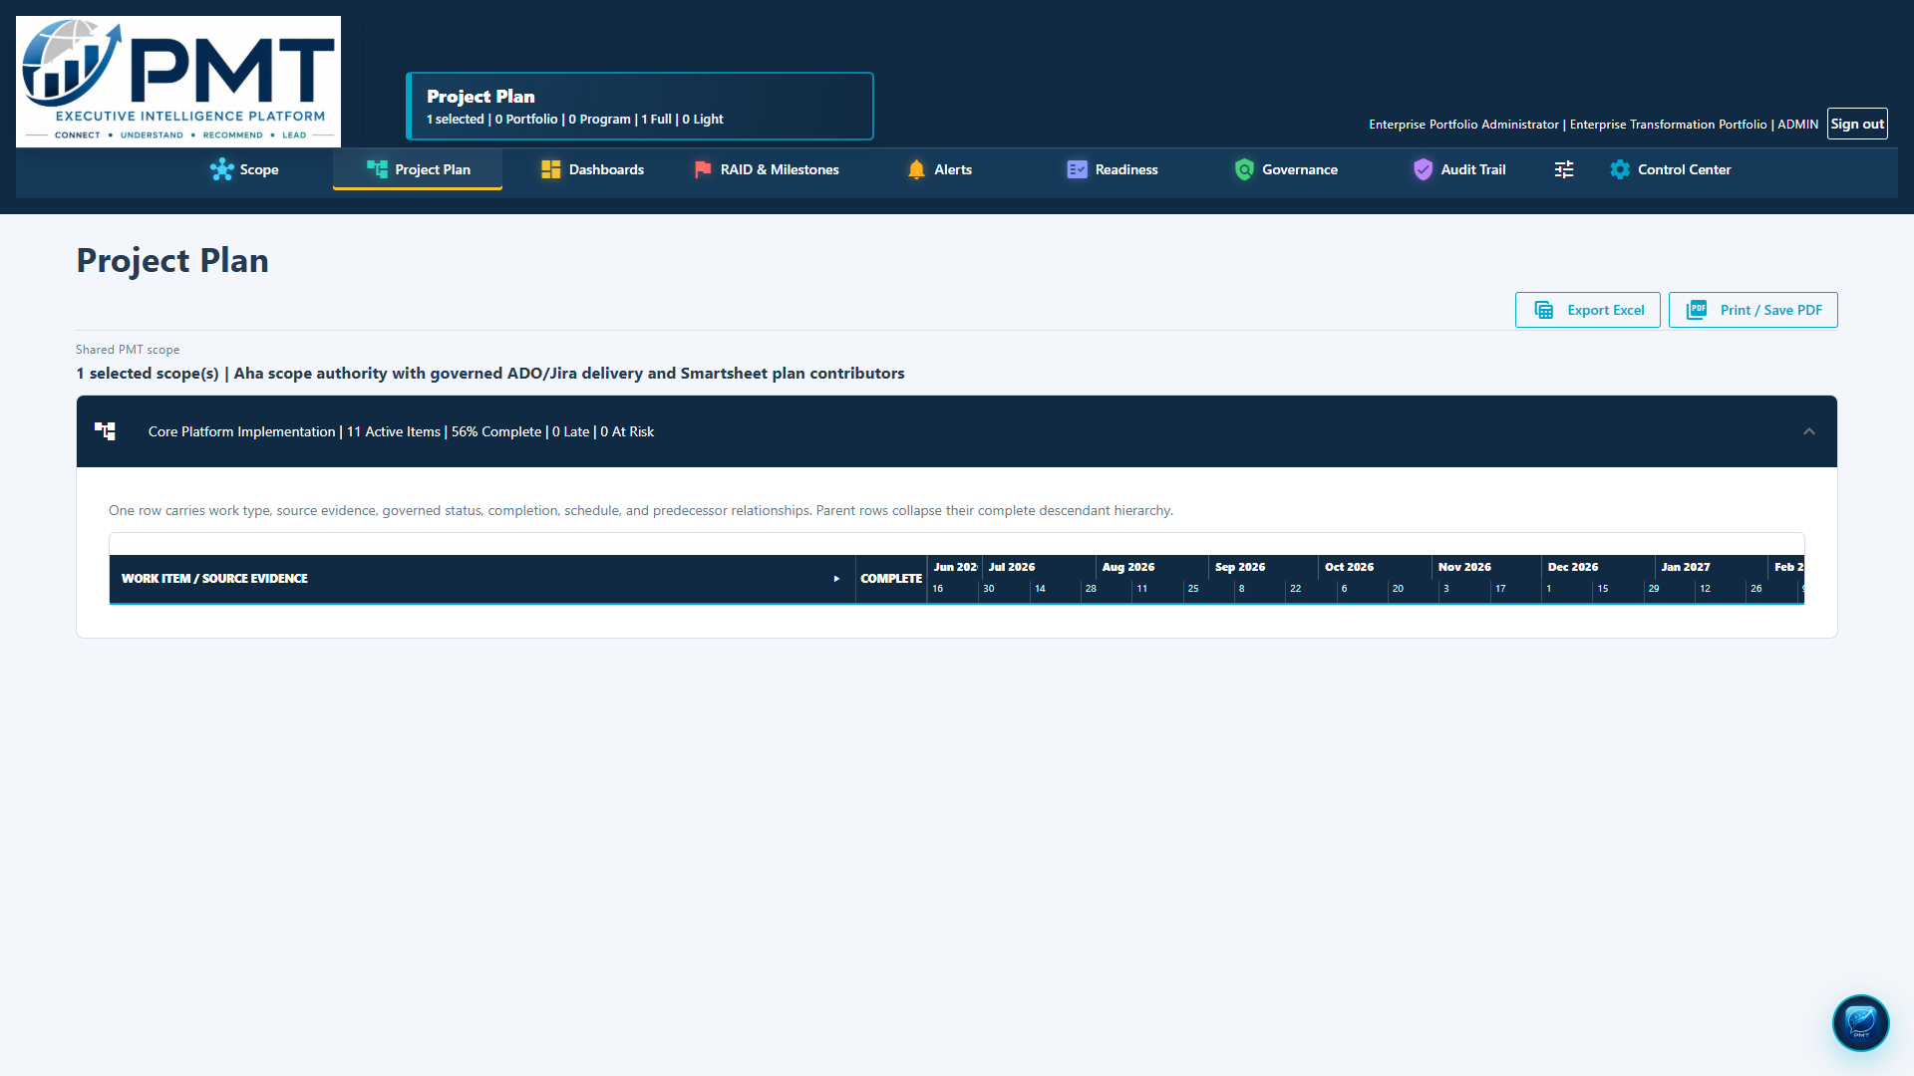
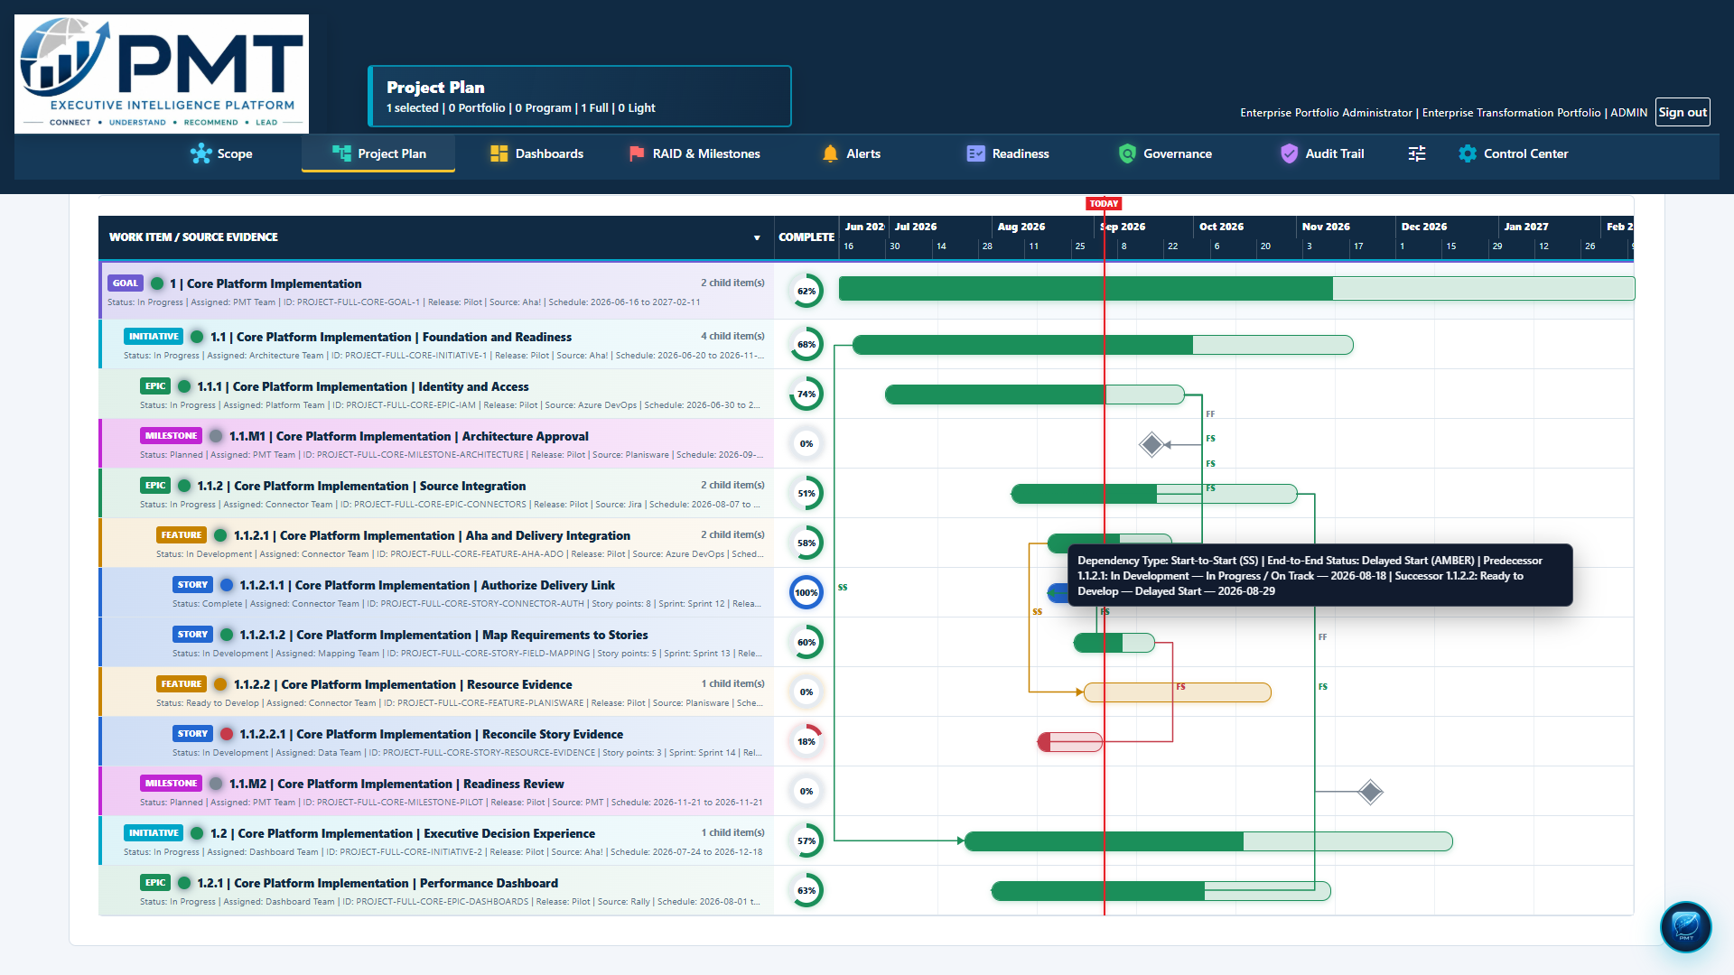
Project plan and dependency evidence
PMT
The hierarchy stays readable while source ownership remains clear
Entire plan control
Dependency context
Selecting Work item / source evidence collapses or expands the complete project plan, not only the next level.
The dependency tooltip identifies type, predecessor, successor, dates, source, and governed status at the point of use.
Supports deep hierarchies
PMT Platform
05
Notes:
Source: Current PMT Platform project plan collapse and dependency tooltip screens.

Slide 6
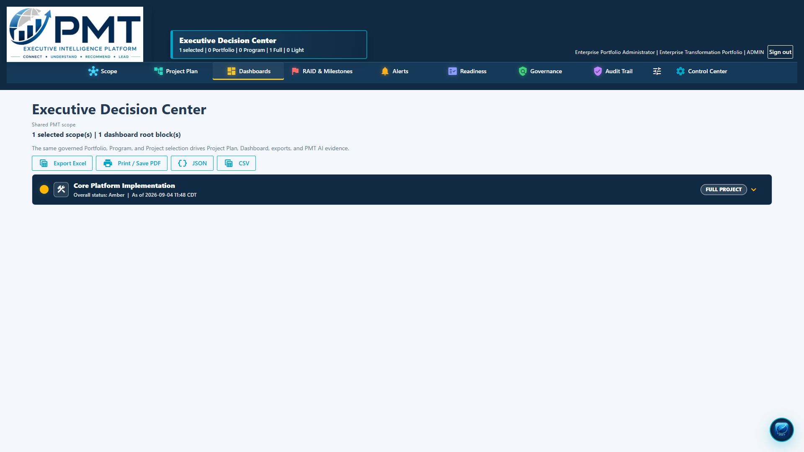
Executive dashboards and status colors
PMT
Visible scope, project type, metric context, and status use the same governed evidence
Status language
BLUE
Context and governed navigation
GREEN
Healthy or on track
AMBER
Attention or emerging concern
RED
Action required
GRAY
Neutral, unavailable, or not assessed
The same color meaning appears wherever delivery status is shown.
PMT Platform
06
Notes:
Source: Current PMT Platform Executive Decision Center. Status definitions follow the approved application color model.

Slide 7
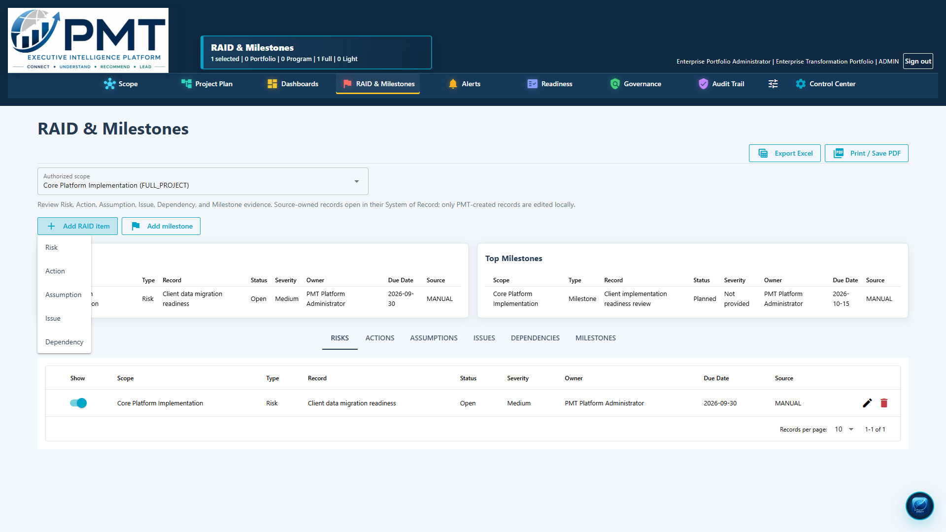
RAID and milestones
PMT
A single governed view covers delivery concerns, commitments, and source ownership
R
Risk
A
Action
A
Assumption
I
Issue
D
Dependency
Milestones remain visible beside RAID records so timing and delivery concerns can be reviewed together.
PMT Platform
07
Notes:
Source: Current PMT Platform RAID and Milestones screen.

Slide 8
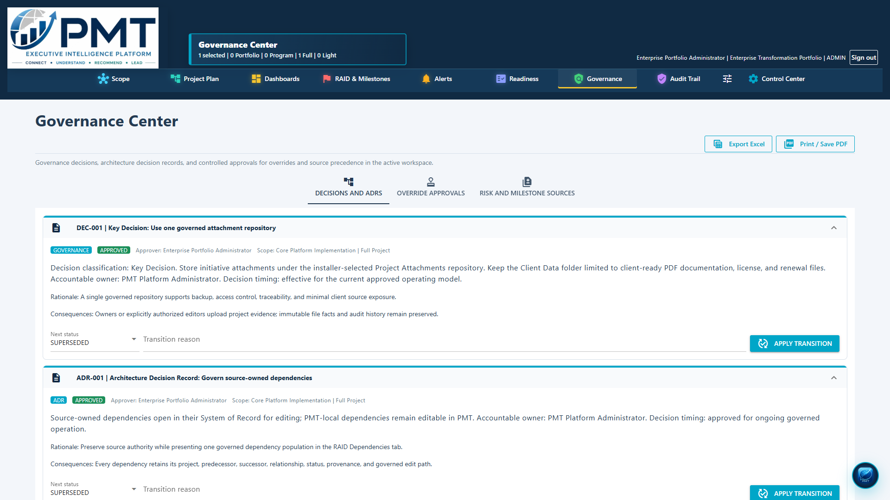
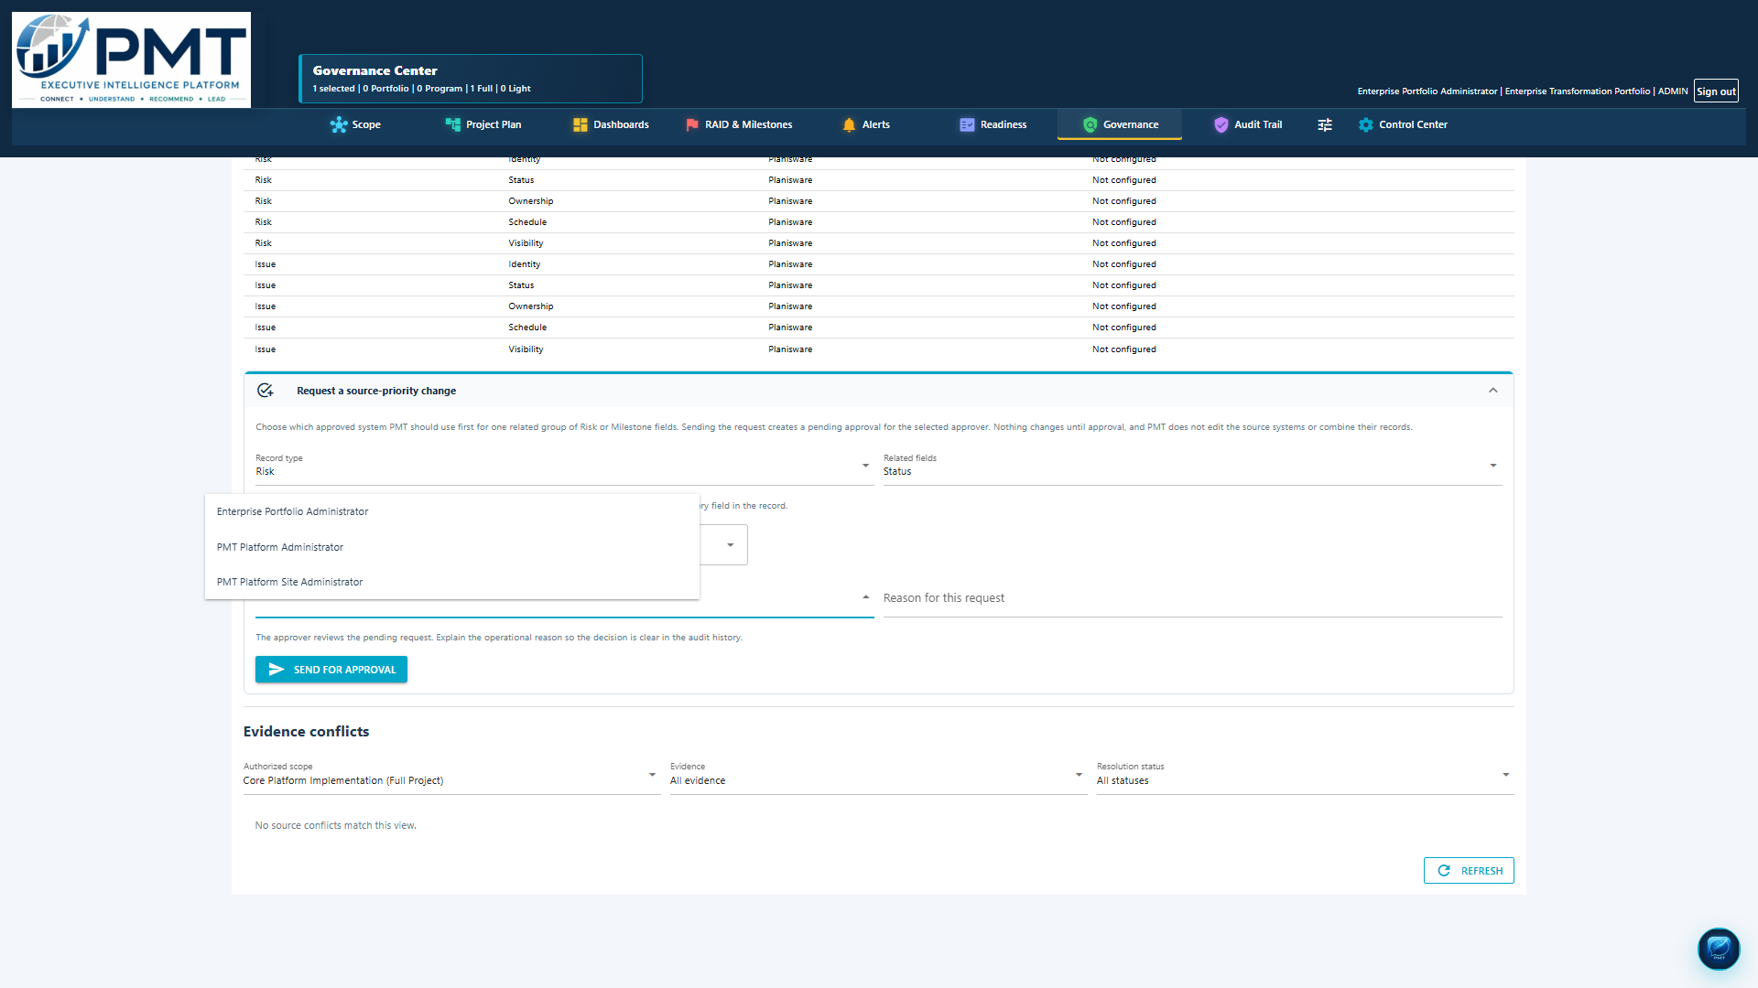
Governance, decisions, and ADRs
PMT
Decision records and architecture rationale complete the delivery picture
Decision and ADR history
Governed precedence changes
Users can review formal decisions and Architecture Decision Records with their supporting evidence, ownership, and status.
A proposed change enters approval. It does not change source authority or merge evidence automatically.
PMT Platform
08
Notes:
Source: Current PMT Platform Governance and precedence proposal screens.

Slide 9
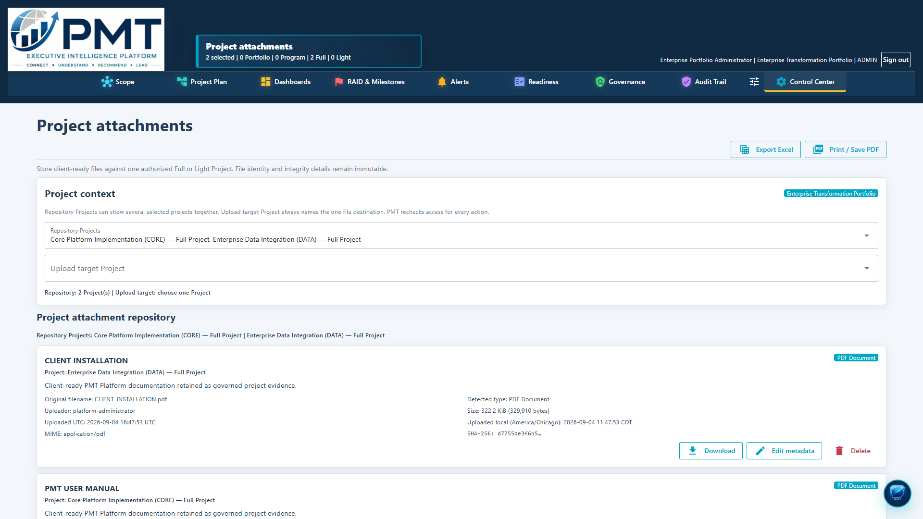
Project attachments and evidence traceability
PMT
Each Full or Light project receives its own governed attachment repository
Simple upload
Owners drag and drop files into the selected project. The file supplies its initial name and type.
Editable business context
Administrators can refine the name, type, and description without changing the stored file evidence.
Complete audit metadata
PMT records the project, user, date, size, source, and related details needed for review.
Installation defines one managed attachment root for all initiatives. Change Configuration displays the active location.
PMT Platform
09
Notes:
Source: Current PMT Platform Project attachments screen and installation configuration.

Slide 10
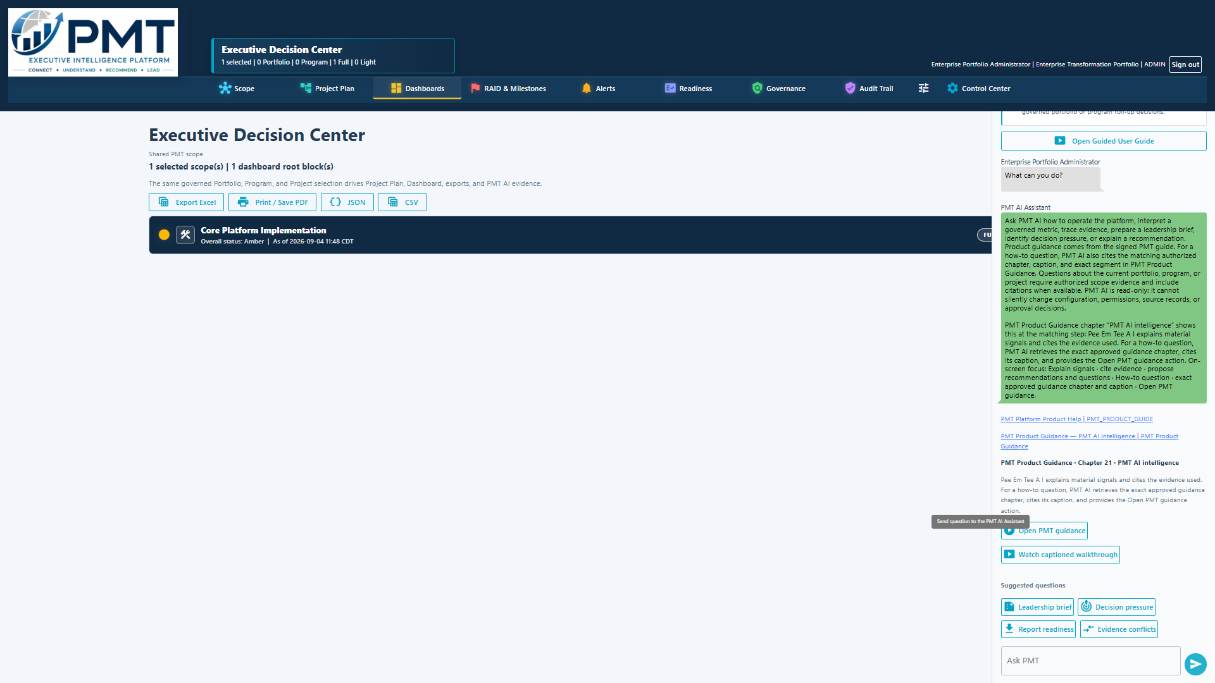
Readiness, alerts, audit, and guided help
PMT
Operational controls use the same governed project evidence
Readiness
Evidence checks show whether a project has the information required for review and decision making.
Alerts and audit
Thresholds and freshness rules surface exceptions. Audit Trail records governed changes and user actions.
PMT Assistant
Guided help answers how to questions and can reference approved portions of the PMT Platform Demo experience.
Guidance remains advisory. Authorized users make and save governed changes.
PMT Platform
10
Notes:
Source: Current PMT Platform product guidance experience.

Slide 11
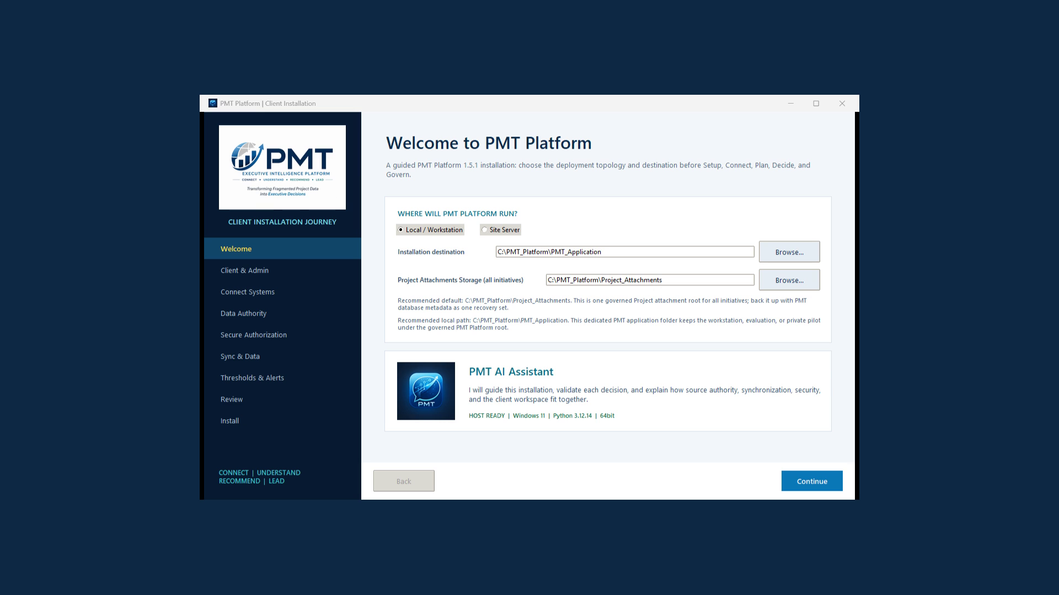
Installation, security, and scale
PMT
The client setup journey keeps paths, secrets, recovery, and validation explicit
Client controlled locations
Setup identifies the application and attachment storage locations. Change Configuration shows the active locations later.
Safe maintenance
Repair and update preserve client state, stop safely on failure, record a support code, and allow an idempotent retry.
Security boundary
Credentials remain protected in the configured vault. Client packages contain the installer and approved PDF documentation without source files.
Validated sample profile: 10 connected systems, 1,000 records per system, 10 project plan levels, and extensive dependency permutations.
PMT Platform
11
Notes:
Source: Current PMT Platform installer and validated scale test profile.

Slide 12
PMT Platform Demo
One website destination for two complementary assets
GUIDED VIDEO
POWERPOINT
See the full PMT experience
Review the building blocks
Installation, connected data, project evidence, dashboards, governance, attachments, and guided help.
Use this presentation for executive briefings, architecture discussions, and client onboarding conversations.
pmt-platform.com
Request a Live Demo remains the tailored follow-up action.
PMT
Notes:
PMT Platform website demo experience. The homepage retains one PMT Platform Demo action and one Request a Live Demo action.

